Slide 1
PREFIX-TREE SEARCH & AUTOCOMPLETE ENGINE
Real-Time Text Retrieval with Tries in C
Algorithmic design, dynamic memory allocation, and recursive traversal for high-throughput search suggestion systems.
Presented by:
DSA Project
Aaditya Panwar and Amrit Sharma

Slide 2



REAL-WORLD MOTIVATION
The Keystroke Query Problem
Sub-10ms Keystrokes
Large Dictionaries
Linear Scans Fail
Every keystroke demands instant completion before the next key press.
Lexicons exceed 100,000 words in modern production systems.
O(N × L) iteration causes input freezes and interface lag.

Slide 3
ALGORITHMIC JUSTIFICATION
Why Linear Arrays Fail
Naive Array / List
Our Solution: Trie
Exhaustive Scanning
Prefix Tree Descent
Scans all N words on every single keystroke. Performance degrades linearly as dictionary grows.
Follows character pointers directly. Lookup cost depends exclusively on prefix length L.
Time: O(N × L)
Time: O(L)
100k words × 5-char prefix = 500,000 comparisons.
Exactly 5 pointer dereferences regardless of dictionary scale.

Slide 4
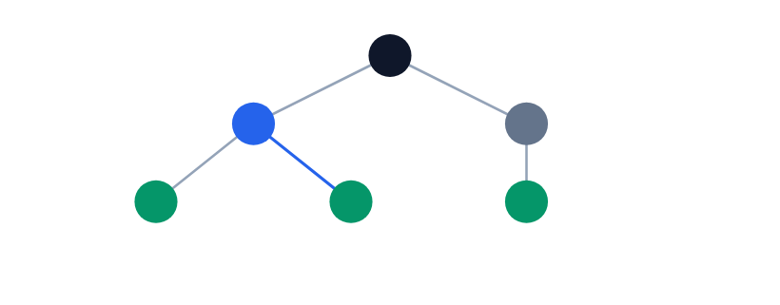
STRUCTURAL MECHANICS
The Trie: Shared Prefix Tree
Root [Ø]
'c'-'a' Shared Path
isEndOfWord = true
Empty string anchor
Reused by cat, car, cap
Terminal word markers

Slide 5
DATA STRUCTURE IN C
Memory Architecture & Struct Definition
Direct O(1) Indexing
struct_trie_node.c
Offset formula: word[i] - 'a' maps 'a'→0 through 'z'→25.
#define ALPHABET_SIZE 26 struct TrieNode { struct TrieNode *children[ALPHABET_SIZE]; bool isEndOfWord; };
#define ALPHABET_SIZE 26 struct TrieNode { struct TrieNode *children[ALPHABET_SIZE]; bool isEndOfWord; };
Boolean Word Flag
Differentiates complete valid words from incomplete prefix steps.
Dynamic Heap Footprint
26 pointers × 8 bytes + 1 bool = ~216 bytes allocated dynamically per node.

Slide 6
SYSTEM PIPELINE
Execution Pipeline Overview
STAGE 01
STAGE 02
STAGE 03
STAGE 04
createNode()
insert()
autocomplete()
printSuggestions()
Heap allocation via malloc and NULL pointer initialization.
Sequential path allocation and terminal node tagging.
Prefix validation and subtree anchor localization in O(L).
Recursive DFS collecting and printing all matching words.

Slide 7
FUNCTION ALGORITHM 1
Algorithm: createNode()
Complexity Bounds
Step-by-Step Procedure
Time: O(1) • Space: O(1)
1.
Allocate memory on heap: malloc(sizeof(struct TrieNode)).
Fixed 26-iteration loop ensures deterministic constant time.
2.
Set newNode->isEndOfWord = false.
3.
Loop i = 0 to 25: initialize children[i] = NULL.
Why NULL Initialization Matters
4.
Return allocated newNode pointer.
Guards against garbage addresses, preventing fatal segmentation faults during branch checks.

Slide 8
FUNCTION ALGORITHM 2
Algorithm: insert(root, word)
Step-by-Step Procedure
Complexity Bounds
1.
Initialize traversal pointer: curr = root.
Time: O(L) • Space: O(L × 26)
2.
Iterate character word[i] until '\0'.
L is word length. Existing prefixes are automatically reused without reallocation.
3.
Compute index: index = word[i] - 'a'.
4.
If curr->children[index] == NULL, allocate via createNode().
Prefix Sharing Property
5.
Advance: curr = curr->children[index].
Words like 'apple' and 'apply' share the first 4 nodes, saving significant heap memory.
6.
Mark completion: curr->isEndOfWord = true.

Slide 9
FUNCTION ALGORITHM 3
Algorithm: autocomplete(root, prefix)
Step-by-Step Procedure
Complexity Bounds
1.
Set curr = root, init local buffer[100] and length = 0.
Time: O(L) • Space: O(1)
2.
Iterate characters in prefix.
Traversal depends exclusively on prefix length L, not total dictionary size N.
3.
If curr->children[index] == NULL, prefix does not exist: print error and return immediately.
4.
Copy char into buffer, increment length, advance curr.
Early Exit Optimization
Non-existent prefixes terminate in under L steps, saving unnecessary computation.
5.
Invoke printSuggestions(curr, buffer, length).

Slide 10
FUNCTION ALGORITHM 4
Algorithm: printSuggestions() (DFS)
Step-by-Step Procedure
Complexity Bounds
1.
Base guard: return if curr == NULL.
Time: O(M) • Space: O(H)
2.
If curr->isEndOfWord: append '\0' and print buffer.
M is subtree nodes visited; H is maximum word length on call stack.
3.
Loop i = 0 to 25 for all children.
4.
If children[i] != NULL:
Natural Alphabetical Order
○
Set buffer[length] = 'a' + i.
Iterating 0 to 25 prints suggestions in lexicographical order without external sorting.
○
Recurse: printSuggestions(child, buffer, length + 1).

Slide 11
THEORETICAL BOUNDS
Computational Complexity Analysis
Function | Time Bound | Space Bound | Engineering Rationale
createNode() | O(1) | O(1) | Allocates fixed 26 pointers + 1 bool.
insert() | O(L) | O(L × Σ) | L characters processed; reuses existing branches.
autocomplete() | O(L) | O(1) | Descends exactly L pointers to find subtree.
printSuggestions() | O(M) | O(H) | M subtree nodes; stack bound to max word length H.

Slide 12
CONCLUSION & SCALABILITY
Deterministic Search Performance
The Trie decouples retrieval latency from dictionary volume, delivering predictable O(L) lookups for interactive applications. Future extensions include compressed Radix Trees and Top-K Min-Heaps.
Thank You

